Slide 1
KAVIKULGURU INSTITUTE OF TECHNOLOGY AND SCIENCE
RAMTEK – 441 106
DESIGN AND IMPLEMENTATION OF VOICE BASED PERSONNAL ASSISTANT
by
Ms. Mansi Joshi (CT15067)
Mr. Rishi Kumar (CT15113)
Mr. Bhupender Yadav (CT15115)
Mr. Aditya Gaurav (CT15117)
Under the guidance of
Mr. Manish Sharma
Assistant Professor
2017-18
DEPARTMENT OF COMPUTER TECHNOLOGY

Slide 2
Topics
Introduction
Literature Review
Virtual Assistant Evolution
Why voice recognition?
Things that VPA can do
Available Applications
Advantages
Advanced applications
Problem to cope
References

Slide 3
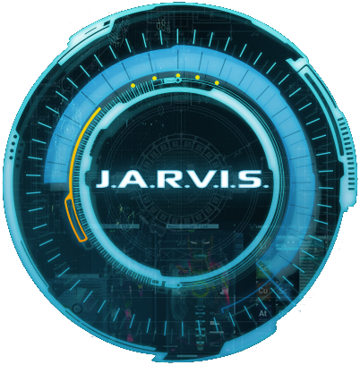
Design and Implementation of Voice Based Personal Assistant
Bringing Intelligence to the Interface

Slide 4
INTRODUCTION
What is Virtual Personal Assistant?
Concept of an artificial personal assistant.
Voice-controlled Personal Digital Assistants.
The combination of :
Automatic Speech Recognition.
Artificial Intelligence.
Natural Language Processing.
Inter Process Communication

Slide 5

A Virtual Personal Assistant:
Does Things for You focus on task completion
Gets What you Say intent understanding via conversation
Gets to Know You learns and applies personal information

Slide 6
Literature Review
The concept of speech recognition started somewhere in 1940s , practically the
first speech recognition program was appeared in 1952 at the bell labs, that was about recognition of a digit in a noise free environment .
1940s and 1950s consider as the foundational period of the speech recognition
technology, in this period work was done on the foundational paradigms of the
speech recognition that is automation and information theoretic models .
In the 1960’s we were able to recognize small vocabularies (order of 10-100
words) of isolated words, based on simple acoustic-phonetic properties of speech
sounds

Slide 7
Virtual Assistant Evolution
Doing Things For You
Service APIs
Data feeds
Auth Standards
Faceted Search Domains
Recommendation Services
Getting What You Say
Location
Speech
Semantic NLP
Linguistic NLP
Date/time
Conversational UI
Social Contexts
Getting Personal
Contacts
Calendars
Explicit Preferences
Profile
Favorites
Learned Preferences
Today
Tomorrow
Future

Slide 8
A Voice based intelligent Personal Assistant named Jarvis which helps in performing tasks written in Python.
What is needed is to put it all together.
Conversational Interface
Location Awareness
Speech to Text
Semantic Data
Time Awareness
Text to Intent
Services APIs
Task Awareness
Dialog flow
Task & Domain
Models
Access to Personal Information

Slide 9
Interaction with the Assistant
Continuous Speech in and out
Conversational Interface - assistant talks back
Delegation of tasks to the assistant
"The future of search is a conversation with someone you trust."
-- John Battelle, The Search

Slide 10
WORKING
Any Virtual Assistant basically
consists of three layers.
Speech to text
Text Analysing
Interpret commands

Slide 11
Why Voice Recognition?
Convenience
Natural user interface: human speech
Improved services for the disabled
Wider range of users
No visual contact required
No special equipment required
Can be done while doing other things
Future possibilities and improvements
Internet use over phones through voice portals
Advanced applications.

Slide 12
VPA Helping you Do Things
Which song you want to play?
Ok . Playing ………
Have basic conversations with user
Playing movies and songs.
Web search and browse
Tell system status, date ,and time.
Open ,close, create a file in notepad.
Searching Wikipedia.
Status?
This system is named LAPTOP-4F99O2G5 ………….
How are you?
I am fine……..

Slide 13
Understanding Intent in Context
Conversation Context
Task Context
Tell me a joke……..
Close browser….
Who created you???
Shutdown ….
Time Context
Entertainment Context
Tell me the date…..
Play a video……..
What’s the system status…..
Play a song……

Slide 14

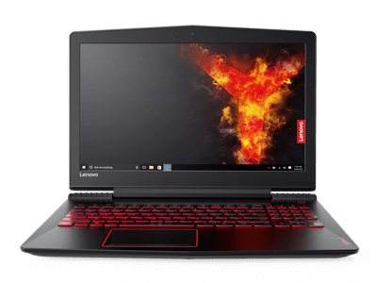




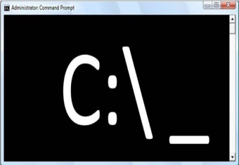
Service Delegation: The Mother of All Mash-ups
Which song you want to play?
Web Services and APIs
Domain & Task Models
Guided Dialog

Slide 15




Employing the services of...
and many more...

Slide 16




A VPA helps you get things done
TIRED
"what do you want to read?"
"at your service"
"at your service(s)"

Slide 17
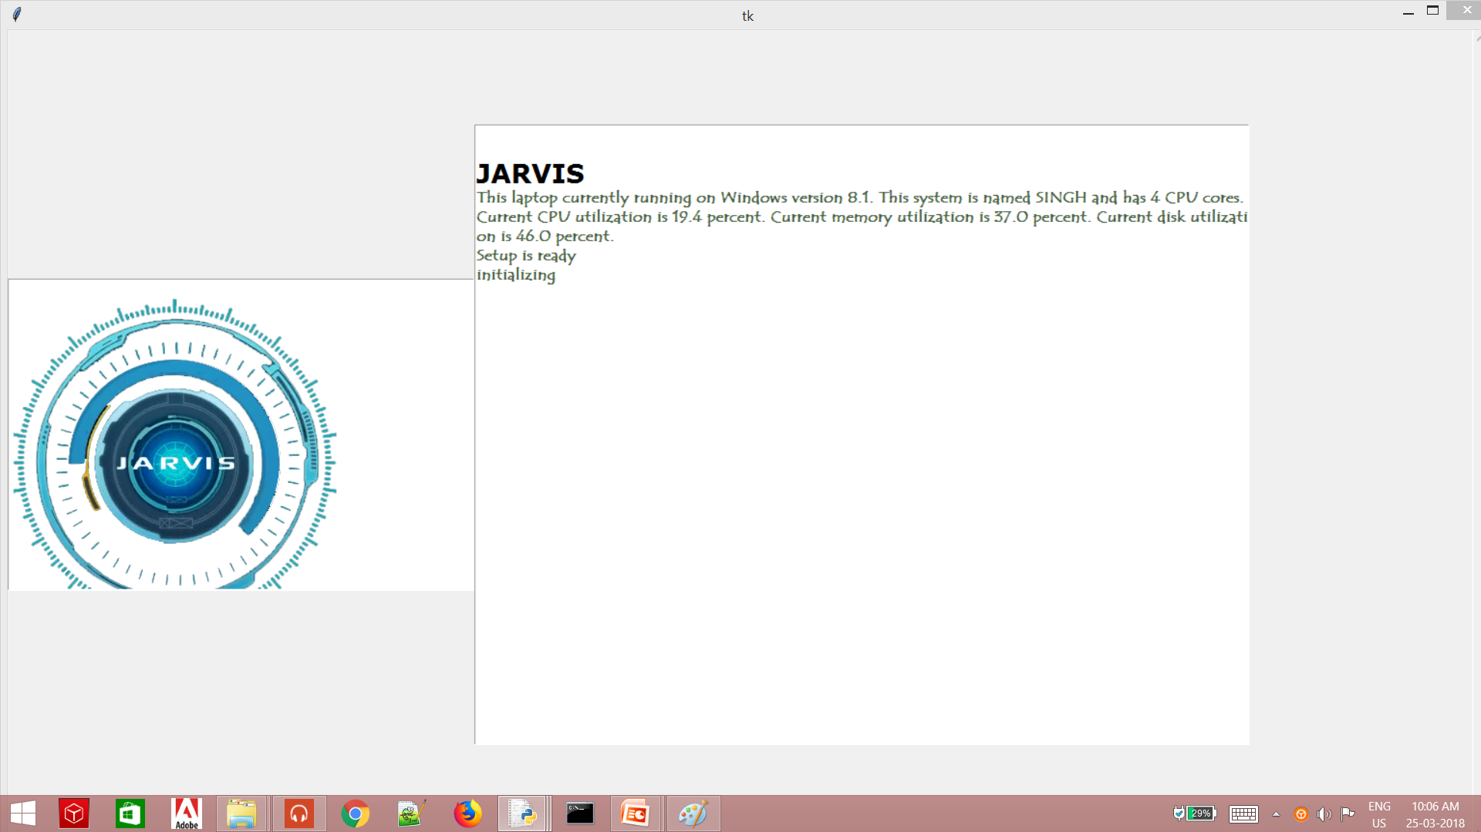
Screenshot

Slide 18
AVAILAIBLE APPLICATION
Name Platform
Google Now Android & IOS
Cortana Windows
Siri IOS
Robin Android
Dragon Go IOS
Evi Android
Easily Do Android 11

Slide 19
EVEN MORE ADVANTAGES
❑ These applications make small and smart hand-held devices to combine multiple features.
❑ They allow you to export and import data.
❑ Store various information.
❑ Make to do lists.
❑ Recognizes voice commands.
❑ Controls various applications of device.
❑ Provides services regarding your location.
❑ Helps to plan your whole day.
❑ Reminds you important things on accurate situations or location.

Slide 20
Advanced Applications
Call Center Automation
Widely used in all industries (consumer interface)
Airline companies: booking flights, general info, etc.
Banking companies: “pay by phone”, account balances, etc.
Delivery Services (FedEx): tracking orders, etc.
All general customer service systems
Computer Integration of voice recognition
Personal Computers
Speech to Text Dictation
Accessibility purposes: voice control of computers

Slide 21
PROBLEMS TO COPE
Listening problem. VPA get problem to process wrong pronounced words and miscellaneous words.
VPA gives response in voice output thus it doesn’t work properly in silent mode.
Most of VPAs can understand only English language.
VPA needs internet connection to give desired output.

Slide 22

PLATFORM
PYTHON 3.6
Command prompt
MODULES
GTTS(Google-Text-To-Speech)
Speech Recognition

Slide 23
REFERENCES
Internet:
1. Natural language processing ,’Steven Bird, Ewan Klien and Edward Looper’.
2. www.tutorialpoint.com/python
3. https://docs.python.org/3/installing/index.html a
4. https://www.analyticsvidhya.com/blog/2017/01/ultimate-guide-to-understand-implement-natural-language-processing-codes-in-python/
5. http://www.nltk.org/ accessed on 23-january-2018
6. Vismaya V, 2 Darvin Reynald J 1 “Natural Language Processing using Python” Student (B.Tech) - Department of IT, Sri Krishna College of Technology, Coimbatore 2 Student (B.Sc) - Department of Computer Science Application & Software Systems, Sri Krishna Arts & Science College, Coimbatore International Journal of Scientific & Engineering Research Volume 8
7. “Study of Voice Controlled Personal Assistant Device” by Abhay Dekate, Chaitanya Kulkarni, Rohan Killedar from Department of computer Engineering, AISSMS College of Engineering, Pune, Maharashtra, India.
8. “Voice Controlled Personal Assistant Using Raspberry Pi”Ass. Prof. Emad S. Othman, Senior Member IEEE - Region 8, High Institute for Computers and Information Systems, AL-Shorouk Academy, Cairo – Egypt, International Journal of Scientific & Engineering Research Volume 8, Issue 11
Books:
1.Learn Python the Hard Way (Author: Zed Shaw)
2.Artificial Intelligence A Modern Approach
(Author:Stuart J. Russell and Peter Norvig)

Slide 24



